Slide 1

Introduction to OO
The way ruby is made!!!!
Anup Kumar K
ROR Developer
akannur@qwinix.io

Slide 2

Agenda
What is Object Oriented Programming?
2) Everything in ruby is object!!!!
3) Encapsulation
4) Polymorphism
5) Inheritance
6) Classes
7) Objects
8) Modules
9) Methods

Slide 3
What is Object Oriented Programming?
Object Oriented Programming, often referred to as OOP, is a programming paradigm that was created to deal with the growing complexity of large software systems. Programmers found out very early on that as applications grew in complexity and size, they became very difficult to maintain. One small change at any point in the program would trigger a ripple effect of errors due to dependencies throughout the entire program.

Slide 4
Classes
Ruby defines the attributes and behaviors of its objects in classes. You can think of classes as basic outlines of what an object should be made of and what it should be able to do. To define a class, we use syntax similar to defining a method. We replace the def with class and use the CamelCase naming convention to create the name. We then use the reserved word end to finish the definition. Ruby file names should be in snake_case, and reflect the class name

Slide 5
Methods
Ruby methods are very similar to functions in any other programming language. Ruby methods are used to bundle one or more repeatable statements into a single unit.
Method names should begin with a lowercase letter. If you begin a method name with an uppercase letter, Ruby might think that it is a constant and hence can parse the call incorrectly.
Methods should be defined before calling them, otherwise Ruby will raise an exception for undefined method invoking.

Slide 6
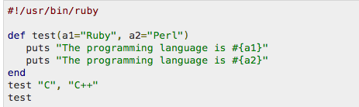
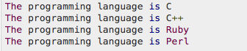
Methods Examples

Slide 7
Objects
Throughout the Ruby community you'll often hear the phrase, "In Ruby, everything is an object!".But it's true; everything in Ruby is an object. Objects are created from classes. Individual objects will contain different information from other objects, yet they are instances of the same class.

Slide 8
Ruby an Object Oriented Programming?
How can we prove this?
Let’s try an example to see this!

Slide 9
Encapsulation
Encapsulation means that the internal representation of an object is hidden from the outside. Only the object can interact with its internal data.
Encapsulation reduce system complexity and increase robustness by decoupling its components.

Slide 10
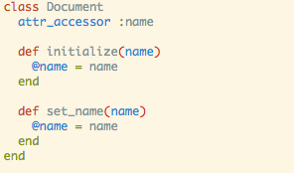
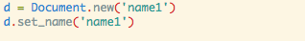
Encapsulation Example

Slide 11
Inheritance
The concept of inheritance is used in Ruby where a class inherits the behaviors of another class, referred to as the superclass. This gives Ruby programmers the power to define basic classes with large reusability and smaller subclasses for more fine-grained, detailed behaviors.

Slide 12
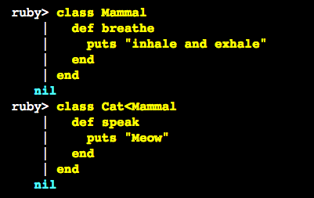
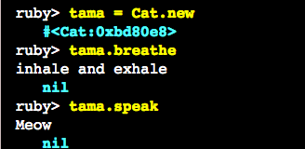
Inheritance Example

Slide 13
Polymorphism
Polymorphism is the ability for data to be represented as many different types. "Poly" stands for "many" and "morph" stands for "forms". OOP gives us flexibility in using pre-written code for new purposes.

Slide 14
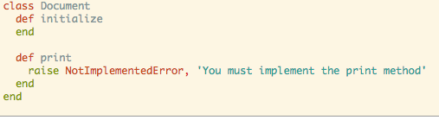
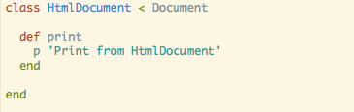
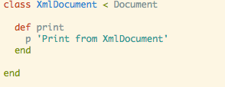
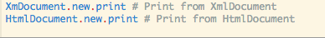
Polymorphism Example

Slide 15
Modules
Modules are another way to achieve polymorphism in Ruby. A module is a collection of behaviors that is useable in other classes. A module is "mixed in" to a class using the include reserved word.

Slide 16
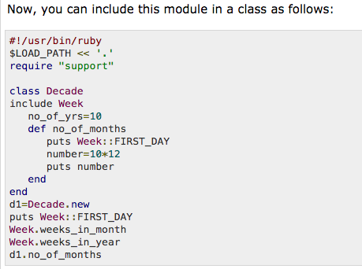
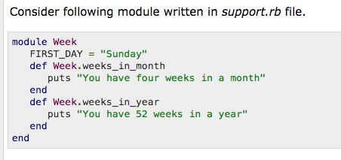
Modules Example

Slide 17





T H A N K Y O U
Mysore I India Qwinix Technologies, Special Plot No 5, Horizon,
Hiema Convention Center Road,
Hebbal Industrial Area, Mysore - 570016
www.qwinix.io | +91 821 2413535
facebook.com/qwinix @Qwinix Qwinix Technologies

